Slide 1


Unmasking Employment scams
An automated system to detect
fraudulent job postings.
Guided by:
Mrs. G. Sai Sree
(Assistant
Professor,AI&DS)
Batch - 6
G.Karthik (21891A7226)
G.Pranay(21891A7217)
K.Balaji(22895A7202)

Slide 2
Table of Contents:
ABSTRACT
INTRODUCTION
LITERATURE SURVEY
EXISTING SYSTEM
PROBLEMS OF EXISTING SYSTEM
PROPOSED SYSTEM
FLOW CHART
SYSTEM ARCHITECTURE
UML DIAGRAM
LIBRARIES AND TOOLS
ADVANTAGES
SAMPLE CODE AND OUTPUT
CONCLUSION
BIBLIOGRAPHY

Slide 3
ABSTRACT
In the digital age, online recruitment platforms have become prime targets for fraudulent job postings, jeopardizing personal and financial information of job seekers. This project addresses this pressing issue by employing a hybrid approach combining data mining and deep learning techniques to detect fake job advertisements. Using the Employment Scam Aegean Dataset (EMSCAD) with 18,000 samples, the study evaluates multiple classification algorithms, including K-Nearest Neighbor (KNN), Decision Tree, Support Vector Machine (SVM), Naive Bayes, Random Forest, Multilayer Perceptron, and Deep Neural Networks.
The analysis reveals that while Random Forest achieves the highest accuracy among traditional methods, the Deep Neural Network classifier, trained with three dense layers, excels with a remarkable 96% accuracy. By focusing on categorical attributes and reducing computational complexity, the model offers an efficient solution to safeguard job seekers. This research contributes significantly to human resource management by automating the detection of fraudulent postings, ensuring safer and more reliable recruitment processes.

Slide 4
Introduction
Opportunities and Challenges
Advances in technology and industry create diverse job opportunities.
Social media and the internet revolutionize job recruitment.
Rising Issue of Fake Job Posts
Increased fraudulent postings cause harassment for job seekers.
Need for Technological Solutions
Leads to loss of trust and reluctance to engage with new opportunities.
An automated system to filter and predict fake job posts.
Enhances trust, security, and efficiency in recruitment.

Slide 5
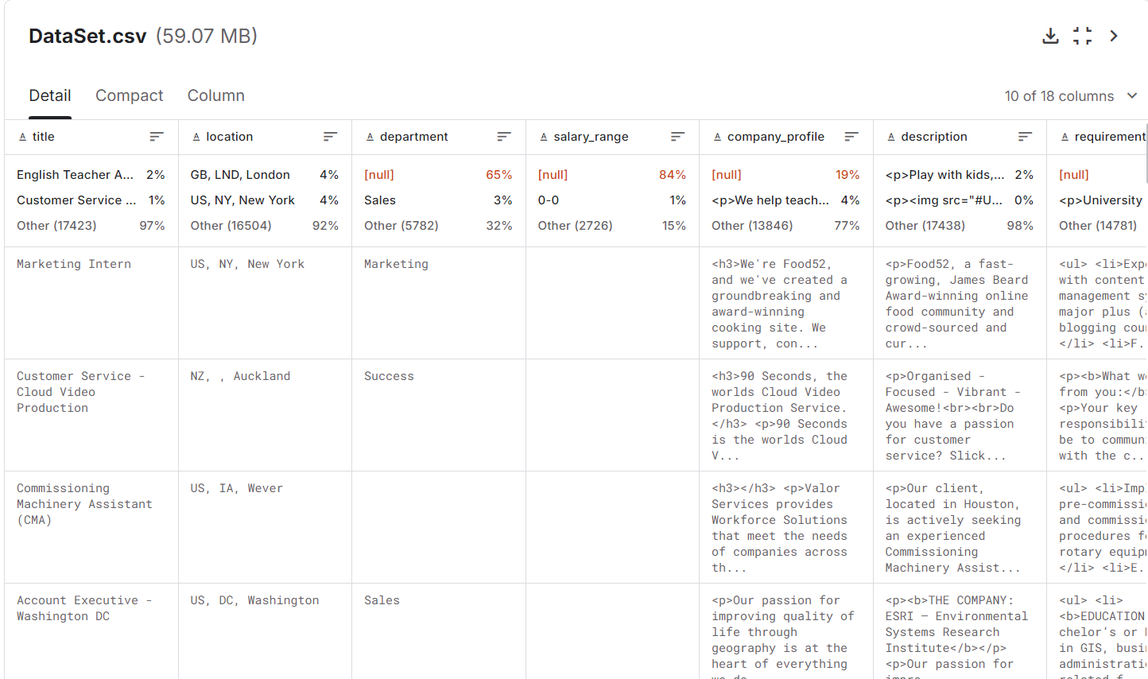
The EMSCAD (employment scam aegean dataset) dataset contains 18,000 job posts, labeled as real or fraudulent.
Dataset Description
It includes features such as job title, company profile, requirements, and employment type.

Slide 6
Literature Survey:
1. Paper: An Intelligent Model for Online Recruitment Fraud Detection(2024)
Author : Alghamdi et al
Algorithm : Support Vector Machine (SVM) and Random Forest with ensemble techniques.
Summary : Explores the use of multiple classifiers to identify fraudulent job postings, emphasizing the integration of feature selection techniques
2. Paper: Random Forest-based Fake Job Detection (2024)
Author : Akiti et al.
Algorithm : Random Forest, Decision Tree, SVM, MLP, and Naive Bayes classifiers.
Summary : Compares various classifiers for detecting fraudulent job ads and discusses their implementation using a structured dataset..
3. Paper: Fake Job Post Prediction Using Data Mining (2023)
Author : Shri Udayshankar B. et al.
Algorithm : Deep Neural Network (DNN).
Summary : Discusses a deep learning-based approach for job ad fraud detection, leveraging multiple features from a dataset for prediction..
4.Paper: Fake Job Prediction using Sequential Network (2020)
Author : Ranparia et al.
Algorithm : Sequential Neural Network with NLP-based feature extraction.
Summary : Highlights the application of NLP and neural networks to analyze job ad tone and structure for fraud detection.

Slide 7
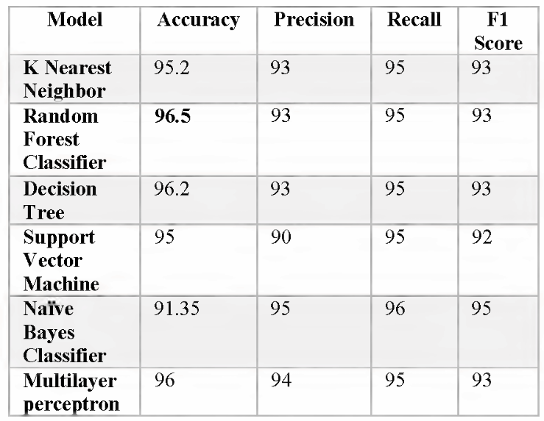
Existing System
Existing System:
The current system is a comparative study of various machine learning algorithms on the EMSCAD dataset, aimed at evaluating their performance in identifying fake job posts.
Algorithms Used:
Model | Accuracy (%) | Precision (%) | Recall (%) | F1-Score (%)
Support Vector Machi | 84 | 86 | 85 | 84.5
Naive Bayes | 86 | 80 | 81 | 82
Multilayer Perceptron | 85 | 79 | 80 | 81.5
Random Forest | 88 | 90 | 89 | 89.5

Slide 8
Problems of the existing system
Inability to Store and Analyze Data Effectively
The current system poses a comparative study on various machine learning algorithms on the EMSCAD dataset, aimed at evaluating their performance in identifying fake job posts
The EMSCAD dataset contains a lot of features which are irrelevant for the fake job prediction which decreases the performance of the model
Scammers continuously update their tactics, and existing systems are often slow to adapt due to old[rigid] models or lack of real-time updates

Slide 9
Proposed System
Developing a system using the XGBoost Algorithm to enhance accuracy and enable real-time detection of fake job posts
XGBoost is chosen for its high efficiency and ability to handle complex data structures.
The new system will predict and detect fake job posts more accurately, leveraging XGBoost's feature importance capabilities to identify crucial attributes.
Additionally, the system will store the job details in the data base for the further analysis purpose

Slide 10
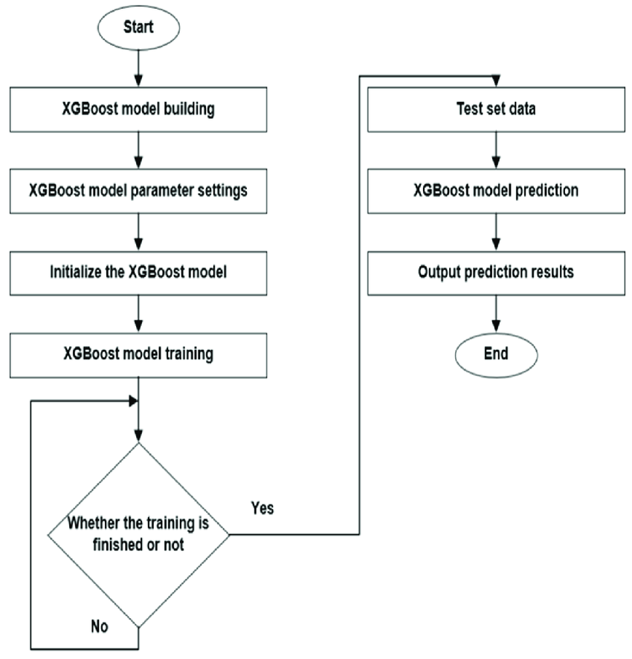
Flow chart :

Slide 11
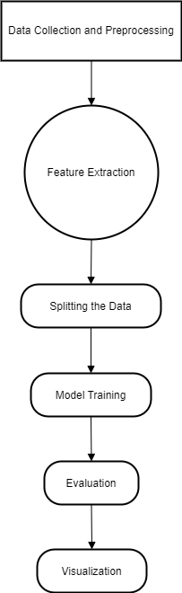
System Architecture

Slide 12
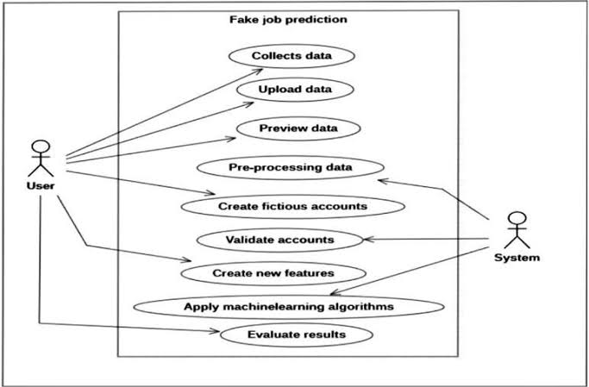
UML DIAGRAM

Slide 13
Advantages
Improved Accuracy: With continuous model refinement, the system can achieve higher accuracy in detecting fake job posts by incorporating new data, features, or improved algorithms.
Scalability: As more data becomes available, system can be scaled to handle large datasets efficiently, allowing it to detect fake job postings across a variety of platforms and industries.
Real-time Detection: Future versions could offer real-time job post verification, which would provide timely alerts and prevent users from applying to fraudulent jobs.

Slide 14
Advantages
Enhanced User Experience: An easy-to-use interface could be developed, allowing users (job seekers or platform administrators) to check the authenticity of job postings quickly and with minimal effort.
Adaptive Learning: With ongoing feedback from users, the system could continuously learn from new patterns of fake job postings, helping to identify evolving tactics used by fraudsters.
Cross-Platform Detection: The system could be extended to detect fake job posts across multiple platforms (websites, social media, etc.), providing comprehensive protection for job seekers.

Slide 15
Libraries and Tools:
Matplotlib & Seaborn (plt, sns):Libraries for data visualization. Matplotlib is used to create static, animated, and interactive plots. Seaborn enhances visualizations with built-in themes.
XGBoost (xgboost, XGBClassifier):Powerful library for gradient boosting. XGBClassifier is used for classification tasks, ideal for predicting fake job posts.
Scikit-learn (train_test_split, TfidfVectorizer, metrics):
train_test_split: Splits data into training and testing sets.
TfidfVectorizer: Converts text data into numerical form using TF-IDF(Term frequency-Inverse Document Frequency) method for machine learning modules.
Metrics: Includes functions like accuracy, precision, recall, and confusion matrix for model evaluation.

Slide 16
Libraries and Tools
XGBoost Plotting (plot_importance):Visualizes feature importance, helping in understanding the relevance of different features in the model’s decision-making process.
Pandas (pd):Used for data manipulation and analysis. Helps in reading, cleaning, and processing structured data (CSV files).
NumPy (np):Provides support for large multidimensional arrays and matrices. Used for numerical operations and data processing.

Slide 17
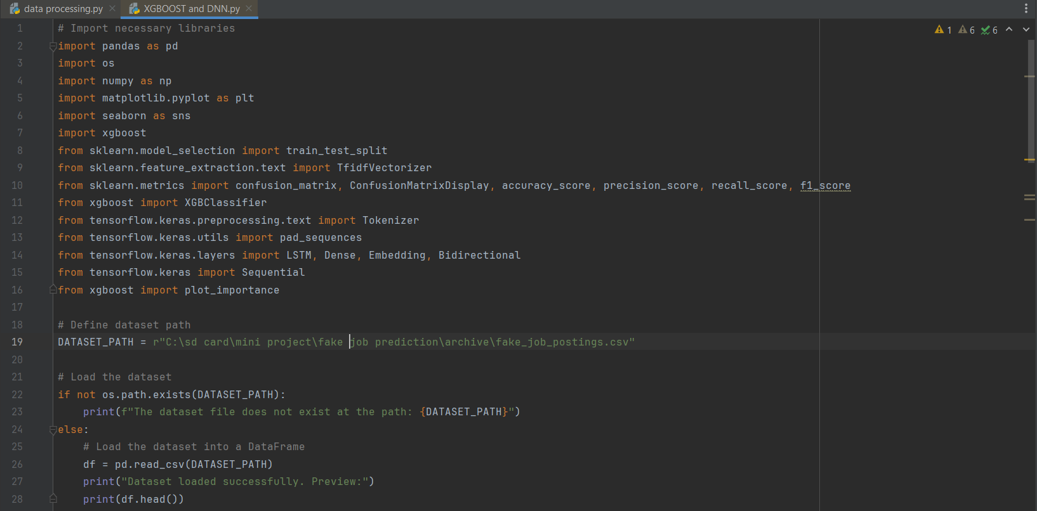
Sample Code

Slide 18
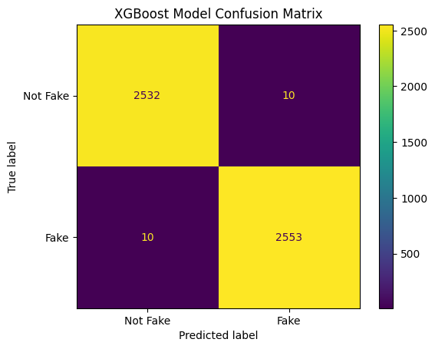
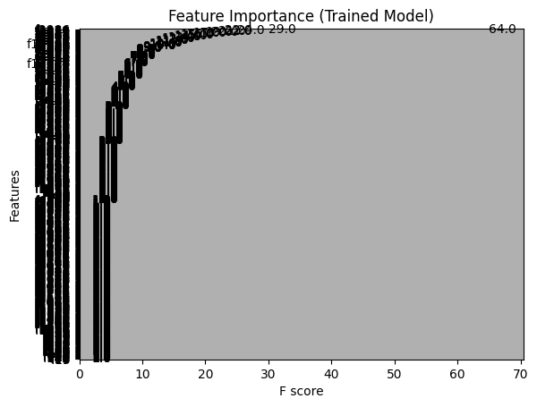
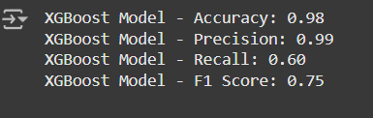

Slide 19
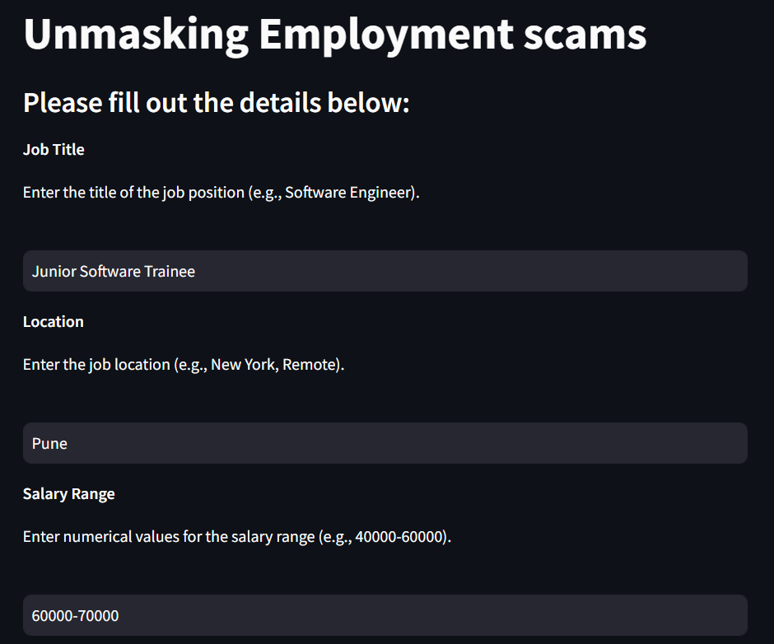
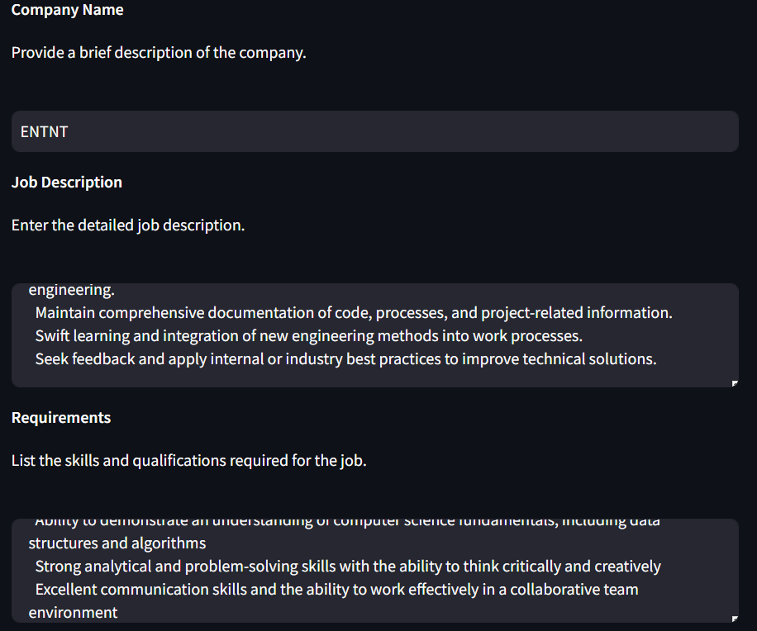
Output:

Slide 20
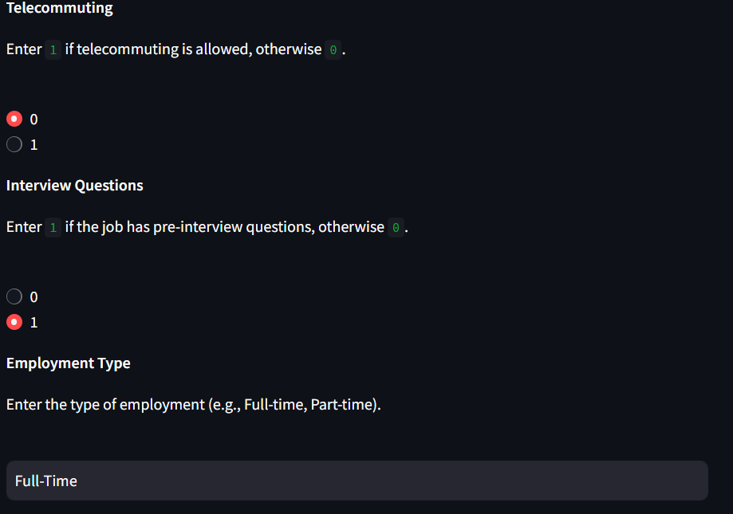
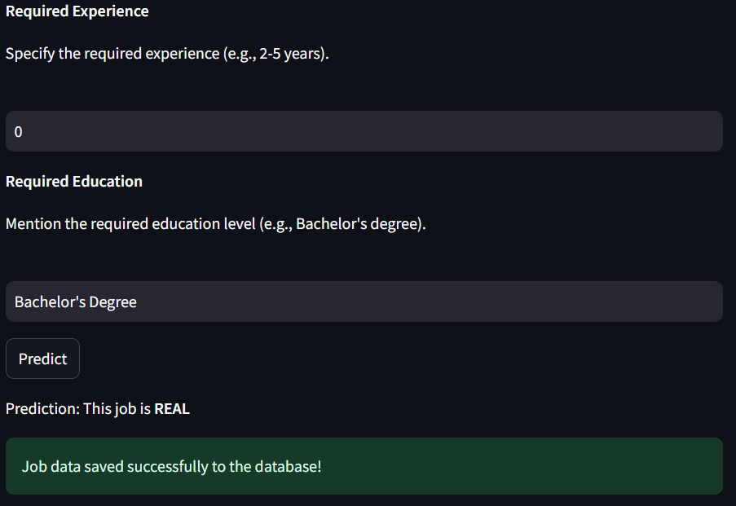

Slide 21
Conclusion
Project Overview:
Developed a system to detect fake job postings using machine learning, leveraging the XGBoost algorithm for classification.
Focused on identifying fraudulent job posts using features like job title, company profile, and job description.
Model Development:
Preprocessed and cleaned the dataset, including feature extraction from text data.
Applied XGBoost for its high accuracy, scalability, and ability to handle imbalanced data.
Evaluated the model's performance using metrics like accuracy, precision, recall, and F1 score.

Slide 22
Bibliography
Vidros, S., Kolias, C., Kambourakis, G., & Akoglu, L. (2017). "Automatic Detection of Online Recruitment Frauds: Characteristics, Methods, and a Public Dataset." Future Internet, 9(6). https://doi.org/10.3390/fi9010006
Alghamdi, B., & Alharby, F. (2019). "An Intelligent Model for Online Recruitment Fraud Detection." Journal of Information Security, 10(3), 155–176. https://doi.org/10.4236/jis.2019.103009
Zhang, J., Dong, B., & Yu, P. S. (2020). "FAKEDETECTOR: Effective Fake News Detection with Deep Diffusive Neural Network." IEEE 36th International Conference on Data Engineering (ICDE).

Slide 23
Bibliography
Kim, Y. (2014). "Convolutional Neural Networks for Sentence Classification." arXiv preprint arXiv:1408.5882.
Van Dang, T., Nguyen, V. D., Nguyen, K. V., & Nguyen, N. L.-T. (2018). "Deep Learning for Aspect Detection on Vietnamese Reviews." NAFOSTED Conference on Information and Computer Science (NICS), 104–109.
Li, H., Chen, Z., Liu, B., Wei, X., & Shao, J. (2014). "Spotting Fake Reviews via Collective Positive-Unlabeled Learning." IEEE International Conference on Data Mining (ICDM), 899–904.
Ott, M., Cardie, C., & Hancock, J. (2012). "Estimating the Prevalence of Deception in Online Review Communities." Proceedings of the 21st International Conference on World Wide Web (WWW), 201–210.

Slide 24
Thank
you

